Slide 1
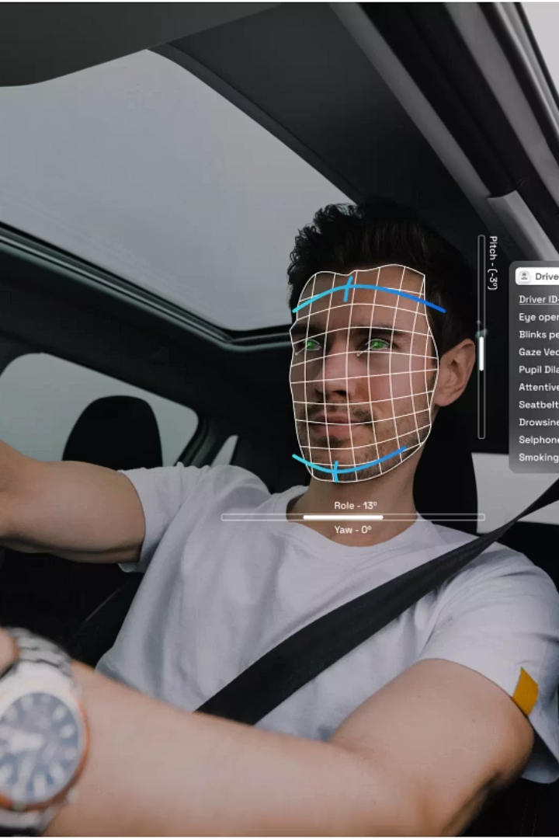
Advanced Driver Monitoring System using Machine Learning
PROJECT STAGE -II
Students name : Gawli Vinay(22265A6703) G Sony(222665A6702) Mentor name : Mr. M Sunil Kumar

Slide 2

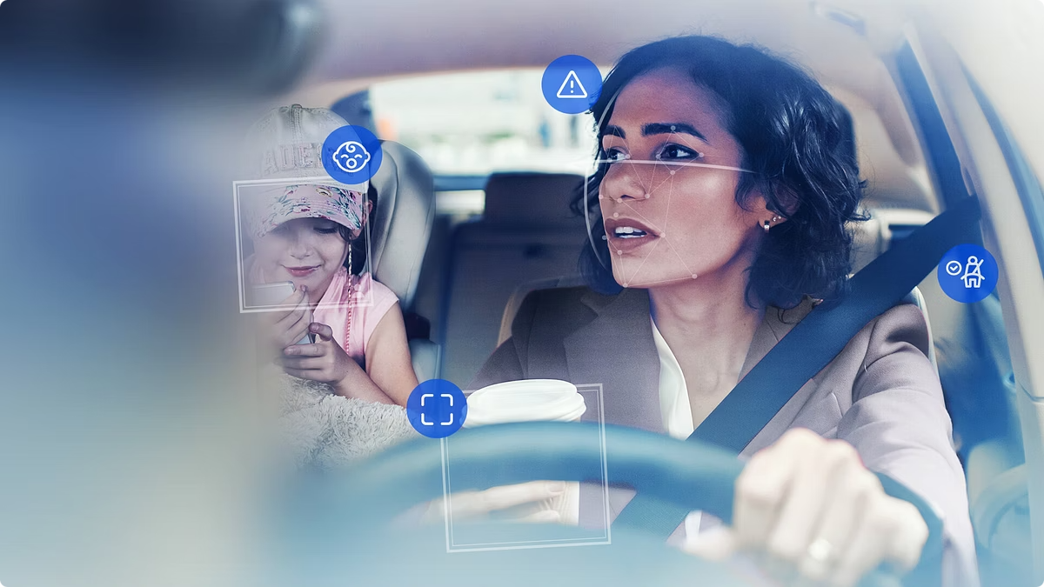
Abstract
This project addresses the growing concern of accidents due to driver fatigue and distraction by developing an Advanced Driver Monitoring System (ADMS) using Machine Learning (ML) and OpenCV. The system analyzes real-time video from an in-car camera, focusing on facial features such as eyes, mouth, and head position to assess alertness.ML algorithms, like Convolutional Neural Networks (CNNs), are used for facial feature detection. Eye blink rate and eyelid closure are monitored to detect drowsiness, while mouth movements identify yawning. OpenCV is essential for real-time image processing and feature extraction. The system predicts the driver's state (alert, drowsy, or distracted) based on these inputs.The ADMS provides timely alerts—visual, audible, or haptic—when drowsiness or distraction is detected, aiming to prevent accidents. Future enhancements could include head pose estimation for detecting prolonged gaze diversion and facial expression recognition to identify stress.
This research offers a practical ADMS prototype, focusing on real-time performance and potential future advancements, contributing to reduced road accidents caused by driver fatigue and distraction.

Slide 3

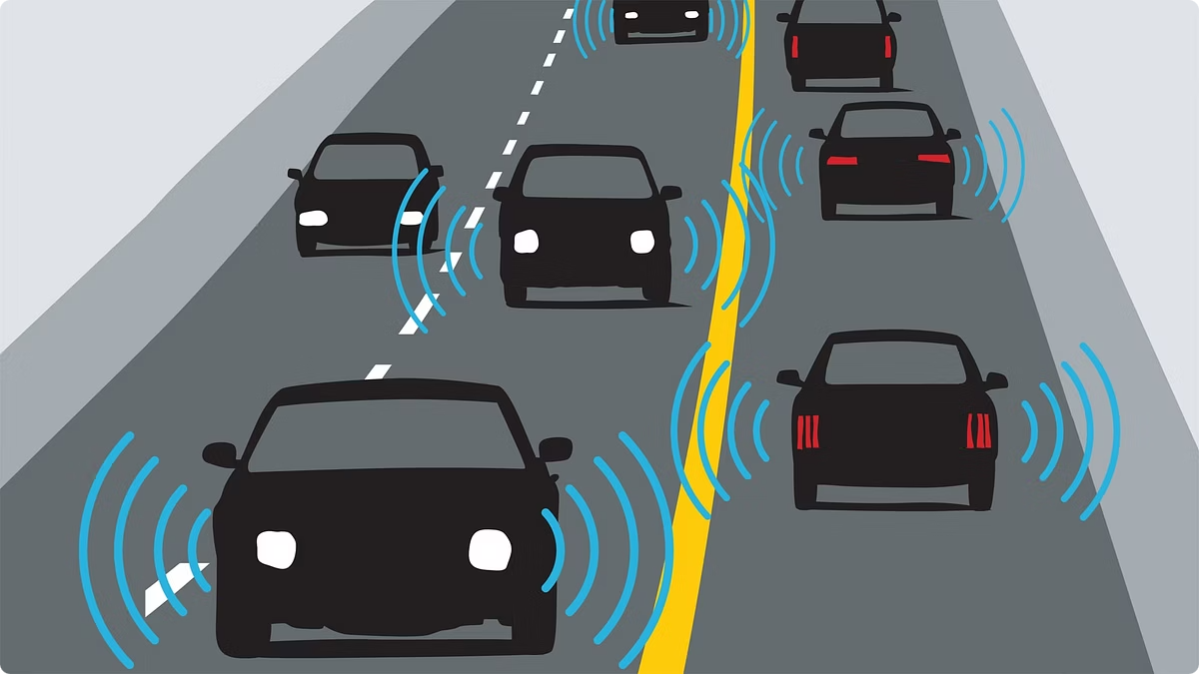
Existing System:
Relies on manual observation or steering-based detection
Low accuracy, especially under real-world conditions
Struggles in poor lighting and varying driver behavior
May require wearables (uncomfortable, not user-friendly)
Prone to false positives and lacks facial monitoring.
Proposed System:
Uses CNN, OpenCV, Dlib for facial feature tracking
Detects drowsiness using EAR and MAR values
Real-time monitoring with audible and visual alerts
Works well in low-light using IR cameras
Can auto-slow vehicle if driver remains unresponsive(future enhancement)
Non-intrusive, cost-effective, and highly accurate.

Slide 4
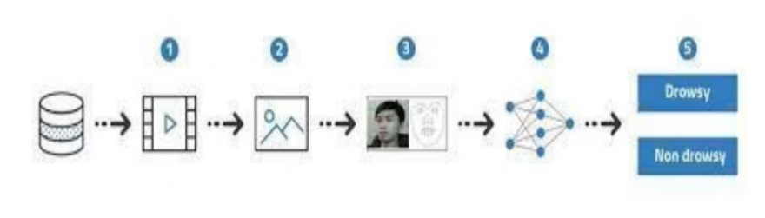
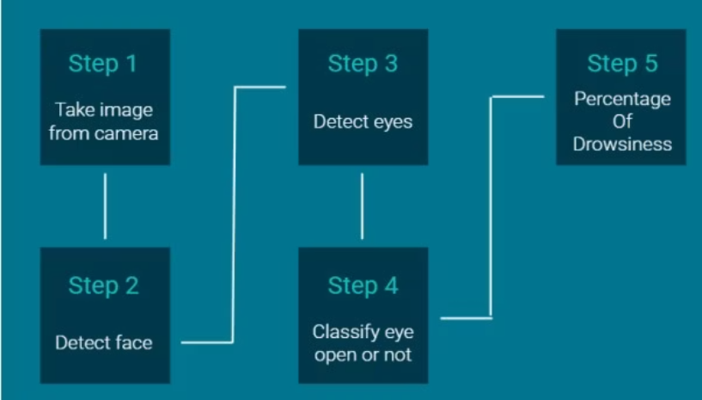
Work Flow Diagram:

Slide 5
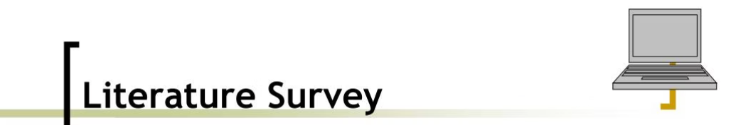
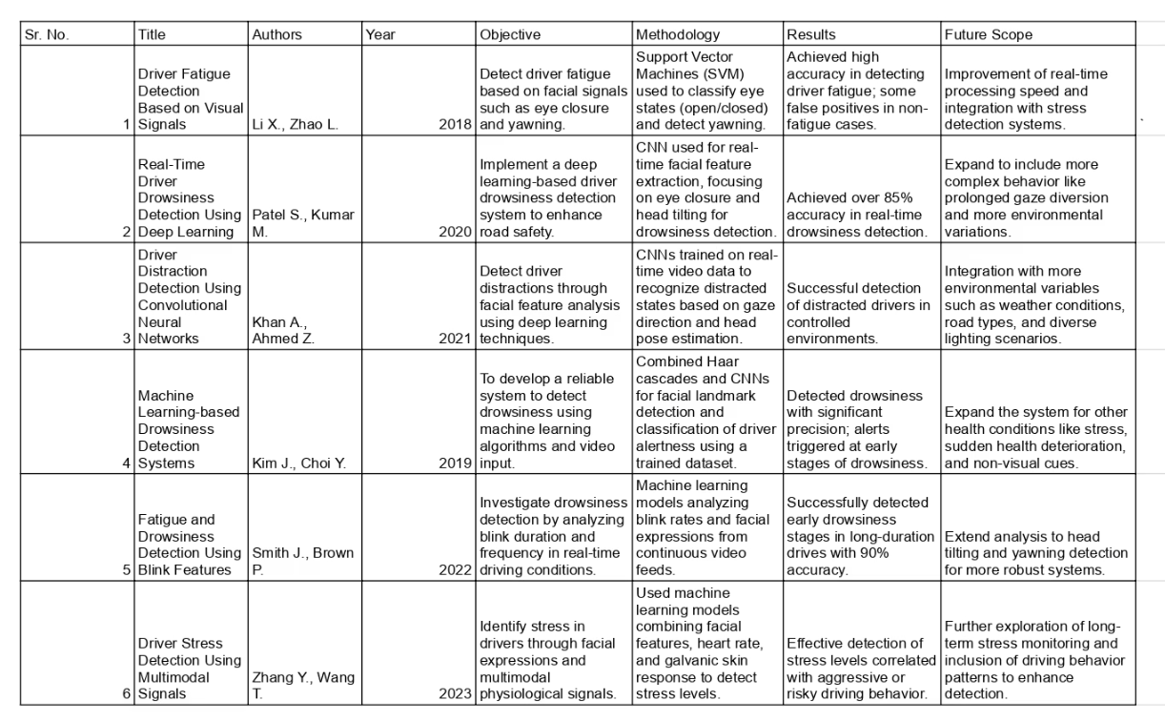

Slide 6
Requirements Specification :
Software Requirements
Operating System: Windows 10 or later, macOS, or Linux (e.g., Ubuntu) ▸ 64-bit OS recommended for better performance
Python: Version 3.7 or later (via Anaconda distribution)
Anaconda: Latest version with Python, Jupyter Notebook, and data science libraries
Visual Studio Code (VS Code): Latest version with Python extension
Hardware Requirements
Processor: Minimum quad-core CPU (e.g., Intel i5/i7, AMD Ryzen 5/7)
Memory (RAM): 8 GB minimum (16 GB recommended)
Storage: At least 20 GB free disk space
Camera: HD webcam or in-car camera (minimum 720p) for real-time facial.

Slide 7
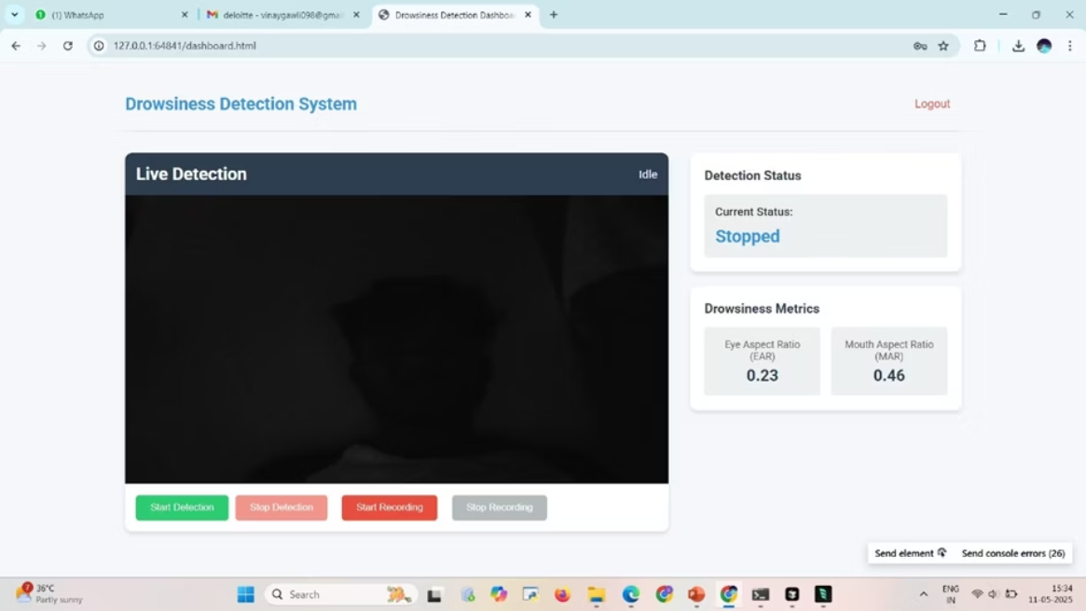
Execution:

Slide 8
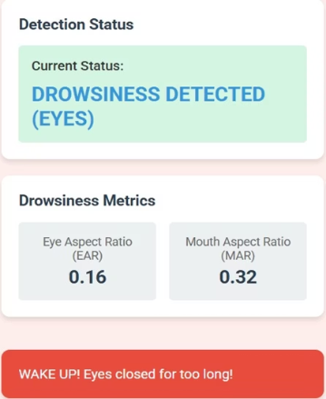
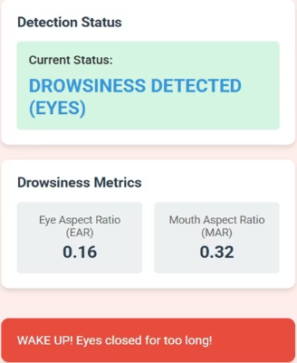
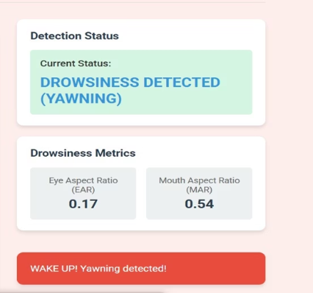

Slide 9
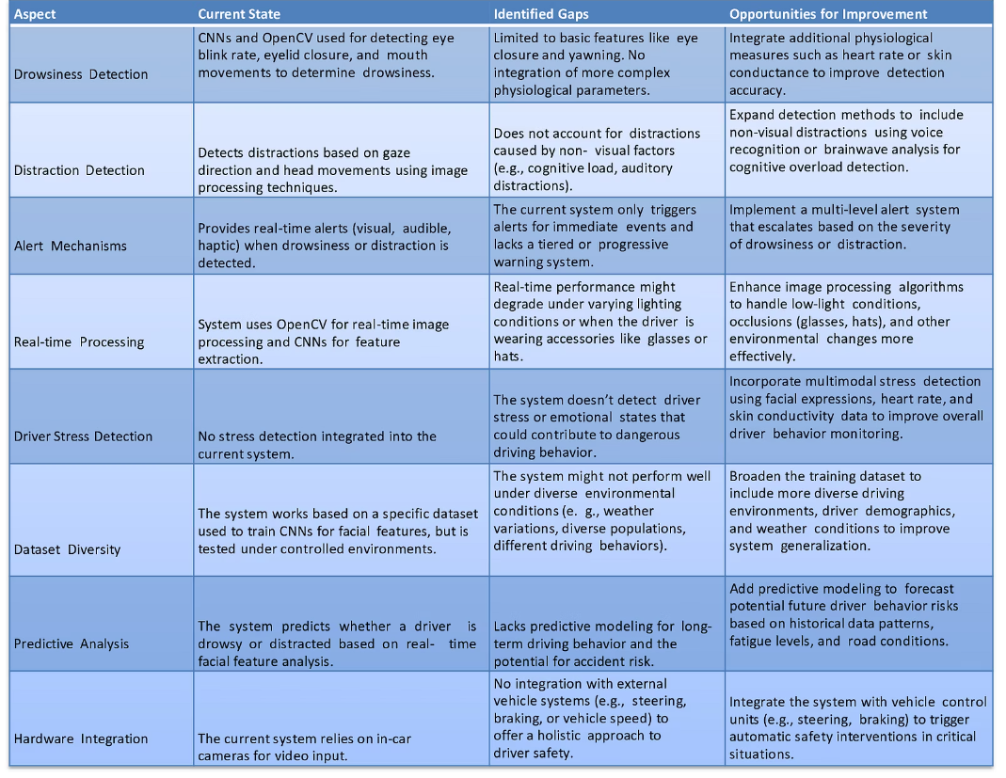
Gap Analysis:

Slide 10
References :
Manu, B. N. 2016. Facial features monitoring for real time drowsiness detection. 2016 12th International Conference on Innovations in Information Technology (IIT).
Alshaqaqi, B., Baquhaizel, A. S., Amine Ouis, M. E., Boumehed, M., Ouamri, A., & Keche, M. 2013. Driver drowsiness detection
system. 2013 28th International Workshop on Systems, Signal Processing and Their Applications (WoSSPA).
Baek, J. W., Han, B.-G., Kim, K.-J., Chung, Y.-S., & Lee, S.-I. 2018. Real-Time Drowsiness Detection Algorithm for Driver State
Monitoring Systems. 2018 Tenth International Conference on Ubiquitous and Future Networks (ICUFN).
You, F., Li, X., Gong, Y., Wang, H., & Li, H. 2019. A Real-time Driving Drowsiness Detection Algorithm with Individual
Differences Consideration. IEEE Access, vol. 7, pp. 179396-179408.
Dasgupta, A., Rahman, D., & Routray, A. 2018. A Smartphone-Based Drowsiness Detection and Warning System for Automotive
Drivers. IEEE Transactions on Intelligent Transportation Systems, 1–10.
Eraldo, B., Quispe, G., Chavez-Arias, H., Raymundo-Ibanez, C., & Dominguez, F.
Design of a control and monitoring system
to reduce traffic accidents due to drowsiness through image processing. 2019 IEEE 39th Central America and Panama Convention (CONCAPAN XXXIX).
Lashkov, I, Kashevnik, A., Shilov, N., Parfenov, V, & Shabaev, A. 2019. Driver Dangerous State Detection Based on OpenCV.
Dlib Libraries Using Mobile Video Processing. 2019 IEEE International Conference on Computational Science and Engineering
(CSE) and IEEE International Conference on Embedded and Ubiquitous Computing (EUC).
Zhang, S., & Wang, X. 2013. Human detection and object tracking based on Histograms of Oriented Gradients. 2013 Ninth
International Conference on Natural Computation (ICNC).
Kamran, M., Mannan, M., & Jeong, Y. 2019. Drowsiness, Fatigue and Poor Sleep ‘s Causes and Detection: A Comprehensive Study.
IEEE Access, vol. 7, pp. 167172-167186.

Slide 11
Conclusion
The proposed system was first implemented in web browsers and later in android applications to be easily accessible as these gadgets are basic requirements of people nowadays and can be found with any and everybody. For monitoring drowsiness of the driver’s alertness, Smartphone is taken as a minimum requirement and by extracting facial and eye gestures alongside its movements as input. This gave a high performance, nonetheless can be taken to a higher degree of performance by fusing more data and information into the same. Some examples are weather forecast, mechanical data of vehicles, signing in and monitoring the driver daily at different drives and the list is endless. Hence, here the real time processing is attained utilizing OpenCV and other required packages for an inclined outcome that gives results with flying colours and the boost in expansion of this technology is exceptionally perceived.The advanced driver monitoring system using machine learning offers a promising solution to enhance road safety and driver awareness.
Potential Benefits
Future Research
This system has the potential to reduce accidents, save lives, and improve the overall driving experience.
Further research and development can focus on improving the system's accuracy, reliability, and user experience.

